Slide 1
Feasibility Analysis
Chapter 3

Slide 2
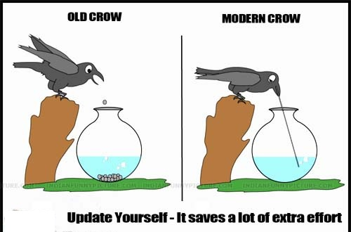

Slide 3
What Is Feasibility Analysis?
Feasibility Analysis
  Feasibility analysis is the process of determining whether a business idea is viable.
  It is the preliminary evaluation of a business idea, conducted for the purpose of determining whether the idea is worth pursuing.
  Feasibility analysis takes the guesswork (to a certain degree) out of a business launch, and provides an entrepreneur with a more secure notion that a business idea is feasible or viable.

Slide 4
When To Conduct a Feasibility Analysis
Timing of Feasibility Analysis
  The proper time to conduct a feasibility analysis is early in thinking through the prospects for a new business.
  The thought is to screen ideas before a lot of resources are spent on them
Components of a Properly Conducted Feasibility Analysis
  A properly conducted feasibility analysis includes four separate components, as discussed in the following slides.

Slide 5
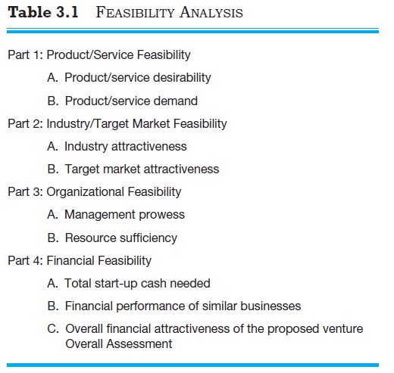
Outline for a Comprehensive Feasibility Analysis

Slide 6
1. Product/Service Feasibility Analysis
Product/Service Feasibility Analysis
  Is an assessment of the overall appeal of the product or service being proposed.
  The idea is that before a prospective firm rushes a product or service into development, it should be confident that the product or service is what its prospective customers want.
  The two components of a product/service feasibility analysis are:
Product/Service
Desirability
Product/Service
Demand

Slide 7
Product/Service Desirability
First, ask the following questions to determine the basic appeal of the product or service.
Does it make sense? Is it reasonable? Is it something consumers
will get excited about?
Does it take advantage of an environmental trend, solve a
problem, or take advantage of a gap in the marketplace?
Is this a good time to introduce the product or service to the
market?
Are there any fatal flaws in the product or service’s basic design
or concept?

Slide 8
Product/Service Desirability
Second, Administer a Concept Test
  A concept statement should be developed.
  A concept statement is a one page description of a business, that is distributed to people who are asked to provide feedback on the potential of the business idea.
  The feedback will hopefully provide the entrepreneur
    A sense of the viability or the product or service idea.
    Suggestions for how the idea can be strengthened or “tweaked” before proceeding further.

Slide 9

Developing a Business Concept
In developing a business concept, consider the features and benefits your proposed product or service will offer.
features distinctive aspects, qualities, or characteristics of a product or service
benefits things that promote or enhance the value of a product or a service to the customer

Slide 10
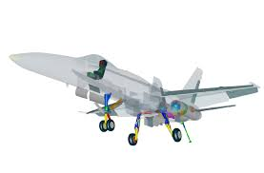
Product/Service Demand
Their are three steps to assessing product/service demand.
Step 1: Administer a Buying Intentions Survey- an instrument that is used to gauge customer interest in a product or service.
Step 2: Conduct library, Internet, and Gumshoe research
Step 3: Usability Testing
  Usability tests are sometimes called user tests, beta tests, or field trials, depending on the circumstances involved.
  Prototype
  Virtual Prototype
  Standard Test Market
  Controlled Test Market

Slide 11
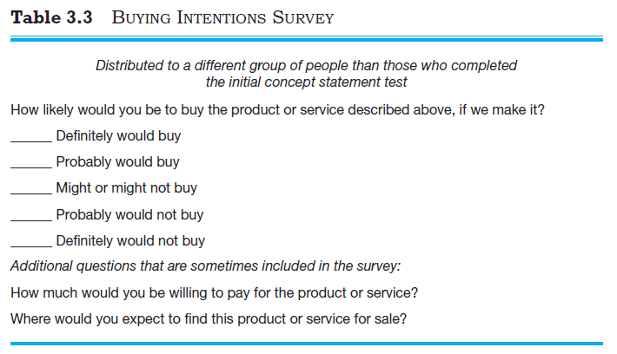

One of the most effective things an entrepreneur can do to conduct a thorough product/service feasibility analysis is to hit the streets and talk to potential customers.

Slide 12
First mover advantage
or
Second-mover advantage
…………?

Slide 13
Entry Strategy For New Entry Exploitation
First Mover- Launching new to the world product or service or at least new to the market. (Pioneer advantage)
First mover faces less competitive rivalry
First movers can secure important channels
First movers are better positioned to satisfy customers
Above-average returns
Customer loyalty
An early hold on market share

Slide 14
Disadvantages of ‘Being First’
Demand Uncertainty: Considerable difficulty in accurately estimating the potential size of the market, how fast it will grow, and the key dimensions along which it will grow.
Technological Uncertainty: Considerable difficulty in accurately assessing whether the technology will perform and alternate technologies will emerge and leapfrog (game) over current technologies.
Uncertainty of Customers: Customers may have considerable difficulty in accurately assessing whether the new product or service provides value for them.

Slide 15
Second Mover –
Responds to first mover, typically through imitation
Is more cautious than first movers
Tends to study customer reactions to product innovations
Tends to learn from the mistakes of first movers, reducing its risks
Takes advantage of time to develop processes and technologies that are more efficient than first movers, reducing its costs
Reduce the entrepreneur’s costs associated with R&D.
Reduce customer uncertainty over the firm.
Notes:
Characteristics of second movers compared to first movers.

Slide 16
Late Mover –
Responds to market opportunities only after considerable time has elapsed since first and second movers have taken action
Has substantially reduced risks and returns
Notes:
Characteristics of late movers compared to first and second movers.

Slide 17
3. Organizational Feasibility Analysis
  It is s concerned with determining whether the business itself has sufficient skills and resources to bring a particular product or service idea to market successfully.
  Focuses on non-financial resources.
  There are two primary issues to consider in this area:
    Management prowess.
    Resource sufficiency.

Slide 18
Management Prowess
Management Prowess
  A firm should candidly evaluate the prowess, or ability, of its management team to satisfy itself that management has the requisite passion and expertise to launch the venture.
  Two of the most important factors in this area are:
    The passion that the solo entrepreneur or the founding team has for the business idea.
    The extent to which sole entrepreneur or the founding team understands the markets in which the firm will participate.
Solo entrepreneurs or founding teams with established social and professional networks also have an advantage
Notes:
skill or expertise in a particular activity or field.

Slide 19

Management Prowess
An indication of passion is the willingness of a new venture team to complete comprehensive feasibility analysis.

Slide 20
Resource Sufficiency
  This topic pertains to an assessment of whether an entrepreneur has sufficient resources to launch the proposed venture.
  The focus here should be on nonfinancial resources in that financial feasibility is considered separately.

Slide 21
Resource Sufficiency
Examples of nonfinancial resources that may be critical to the successful launch of a new business
Availability of affordable office or lab space.
Likelihood of local and state government support of the business.
Quality of the labor pool available.
Proximity to key suppliers and customers.
Willingness of high quality employees to join the firm.
Likelihood of establishing favorable strategic partnerships.
Proximity to similar firms for the purpose of sharing knowledge.
Possibility of obtaining intellectual property protection in key areas.

Slide 22
4. Financial Feasibility Analysis
  For feasibility analysis, a quick financial assessment is usually sufficient.
  The most important issues to consider at this stage are:
    Total start-up cash needed.
    Financial performance of similar businesses.
    Overall attractiveness of the proposed venture.

Slide 23
Total Start-Up Cash Needed
The first issue refers to the total cash needed to prepare the business to make its first sale.
An actual budget should be prepared that lists all the anticipated capital purchases and operating expenses needed to generate the first $1 in revenues.
The point of this exercise is to determine if the proposed venture is realistic given the total start-up cash needed..

Slide 24
Financial Performance of Similar Businesses
  Estimate the proposed start-up’s financial performance by comparing it to similar, already established businesses.
  There are several ways to doing this, all of which involve a little ethical detective work.
    First, there are many reports available, some for free and some that require a fee, offering detailed industry trend analysis and reports on thousands of individual firms.
    Second, simple observational research may be needed. For example, the owners of New Venture Fitness Drinks could estimate their sales by tracking the number of people who patronize similar restaurants and estimating the average amount each customer spends.

Slide 25
Overall Financial Attractiveness of the Proposed Venture
Overall Financial Attractiveness of the Proposed Investment
  A number of other financial factors are associated with promising business startups.
  In the feasibility analysis stage, the extent to which a business opportunity is positive relative to each factor is based on an estimate rather than actual performance

